Slide 1
Computer Networks
1

Slide 2
Server
A server is a type of computer that is equipped with software and hardware to offer services to other computers connected to it.
How are Servers different?
1000s of clients depend on server.
Requires high reliability.
Requires tighter security.
Often expected to last longer.

Slide 3
Server : Hardware Vs. Software
Hardware Server: This refers to the physical machine or computer system designed to provide services or resources to other computers or devices on a network. Optimized for reliability, performance, and scalability, such as powerful processors, large amounts of RAM, multiple network interfaces, and redundant storage.
Software Server: This refers to the software application or program running on a server hardware that provides specific services or functionalities to clients or users over a network.

Slide 4
Types of severs
Web Server:
A web server is software that delivers web content to clients over the internet or a network by processing HTTP/HTTPS requests and serving requested files or web pages
Mail Server:
A mail server is a software application running on server hardware that handles sending, receiving, and storing email messages, facilitating communication between users over networks like the internet.
File server:
A file server is a computer hardware or software system that stores and manages files, allowing clients on a network to access and share data stored on the server.
Cloud Server:
A cloud server is a virtual server hosted and managed by a cloud computing provider, offering scalable computing resources, such as processing power and storage, over the internet

Slide 5
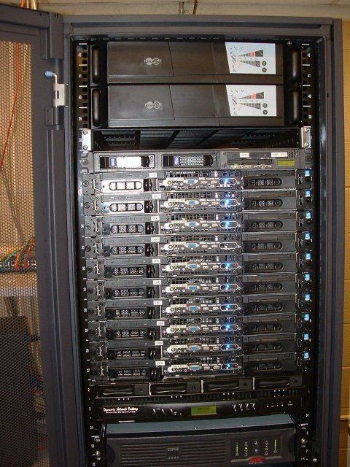
Server Hardware
More internal space.
More CPU/Memory.
More / high-end CPUs.
More / faster memory.
High performance I/O.
Redundancy
concept ensuring backup components or systems are in place to maintain functionality in case of failure
RAID
involves grouping multiple disk drives to improve data reliability, performance,
Notes:
PCI is 133 MB/s, but servers have 66 MHz 64-bit versions at 533 MB/s
PCIe ranges from 250 MB/s (1.0) to 1 GB/s (3.0) per lane, with up to 16 lanes/slot for a maximum of 16 GB/s

Slide 6
Servers Operating system
A server operating system, also called a server OS, is an operating system specifically designed to run on servers, which are specialized computers that operate within a client/server architecture to serve the requests of client computers on the network.
Why is it necessary?
Basically what Server OS does, It provides an interface between the user and the system or application which can be graphical (Windows Server) or Terminal/Command Line based on the OS you are using.
To help manage, store, send and process data large number of documents and their files. to, 24 hours a day, 7 days a week, 356 days a year.
Flexible networking capabilities, Tight system security, Transparent data transfer between different devices. Automation capabilities.
Advanced backup facilities to permit regular and frequent online backups of critical data.
Reconfigure and update both hardware and software to some extent

Slide 7
OS Vs Server OS
An operating system manages resources and provides a user interface on individual computers.
A server operating system is specialized for hosting services managing resources and facilitating network connectivity for multiple users or devices.

Slide 8
Services of server operating system
Administration - what tools are available and how easy are they to use.
Security - perhaps the most important feature, and the hardest to judge and get right.
Stability - what is the downtime.
Features - does it have the specific services you want built in (for instance, or an FTP server for remote file access)
Performance - is the server OS, and the hardware platform it runs on, fast enough for your needs?
Hardware requirements - whether the server OS can run on Intel or AMD hardware, or whether it requires a proprietary platform
Scalability - how many clients can reasonably access this system
Third-party applications - what products are available for the platforms

Slide 9
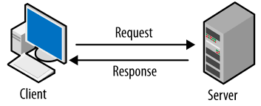
Network Architecture
Refers to how the computer or devices are designed in a network
Basic types:
Client/Server:
All clients must request service from the server
The server is also called a host
Node is any network device
Nodes are called clients

Slide 10
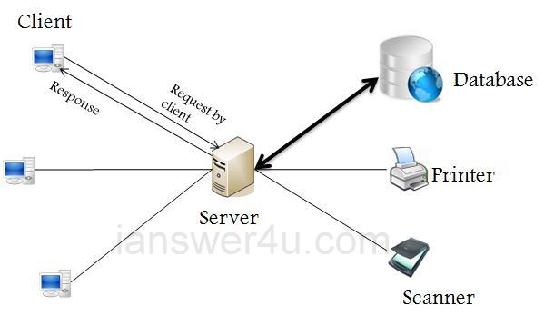
Network architecture
Client/Server Network
Servers are used to control access
Users gain access by logging in
Database software
Access to data controlled by server
Server is the most important computer
Different servers perform different tasks: File server, network server, etc.

Slide 11
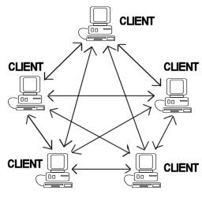
Network architecture
Peer to Peer Networks (P2PN)
All nodes are equal
Nodes access resources on other nodes
Each node controls its own resources
Most modern OS allow P2PN
Good for small businesses and home networks
Simple and inexpensive

Slide 12
TCP/IP Model
The TCP/IP (Transmission Control Protocol/Internet Protocol) is a suite of communication protocols governing how data is transmitted and received across networks, ensuring reliable and standardized communication between devices connected to the internet.

Slide 13
TCP/IP Model
The TCP/IP Model was develop by the US Department of Defense
The layers in the TCP/IP protocol suite do not exactly match those in the OSI model
The original TCP/IP protocol model was defined as having four layers: network access, internet, transport, and application

Slide 14
TCP/IP Model
When TCP/IP is compared to OSI, The network access layer is equivalent to the combination of the physical and data link layer
The internet layer is equivalent to the network layer, and the application layer doing the job of the session, presentation, and application layers

Slide 15
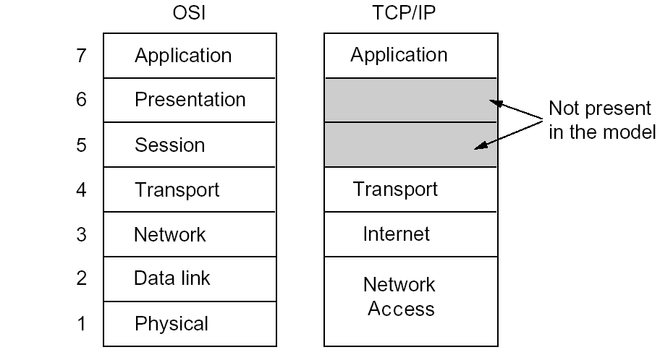
TCP/IP Protocol Model
4

Slide 16
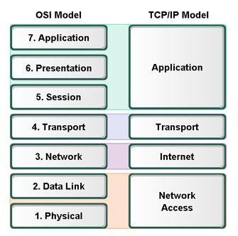
Layers in TCP/IP and OSI Model
OSI and TCP/IP model

Slide 17
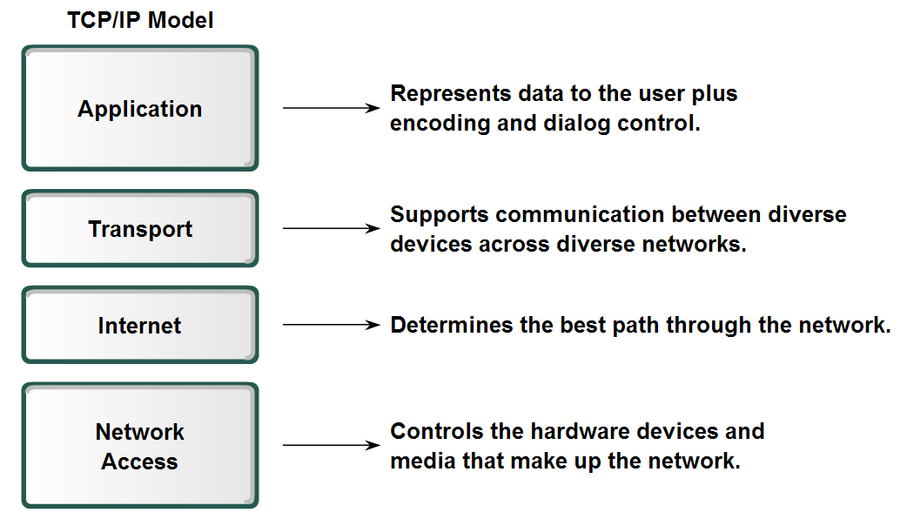
Layers in TCP/IP
TCP/IP Mode

Slide 18
Protocols For Each Layer
FTP-File Transfer Protocol
HTTP-Hypertext Transfer Protocol
SMTP-Simple Mail Transfer Protocol
DNS-Domain Name Service
Application

Slide 19
Protocols For Each Layer
Application
TCP-Transmission Control Protocol
UDP-User Datagram Protocol
Transport

Slide 20
Protocols For Each Layer
Application
Transport
Internet
IP-Internet Protocol

Slide 21
Protocols For Each Layer
Application
Transport Internet
LAN & WAN Technologies
Network Access

Slide 22
Key Differences between TCP/IP and OSI Model
Basis for Comparison | TCP/IP Model | OSI Model
Expands To | TCP/IP- Transmission Control Protocol/ Internet Protocol | OSI- Open system Interconnect
Meaning | It is a client server model used for transmission of data over the internet | It is a theoretical model which is used for computing system
No. Of Layers | 4 Layers | 7 Layers
Developed by | Department of Defense (DoD) | ISO (International Standard Organization)
Tangible | Yes | No
Usage | Mostly used | Never used

Slide 23
Key Differences between TCP/IP and OSI Model
TCP/IP is a client-server model, i.e. when the client requests for service it is provided by the server. Whereas, OSI is a conceptual model
TCP/IP is a standard protocol used for every network including the Internet, whereas, OSI is not a protocol but a reference model used for understanding and designing the system architecture

